Slide 1

St George and the Dragon
can be found everywhere!

Slide 2
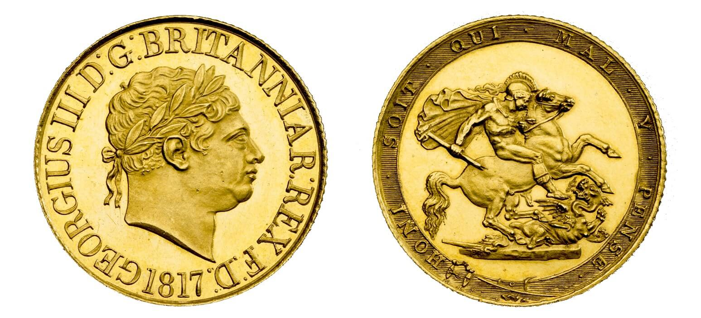
Sovereign of George III from 1817

Slide 3

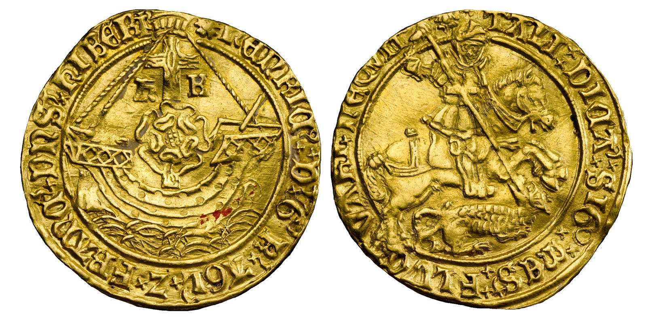
George noble of Henry VIII 1526 to 1544

Slide 4

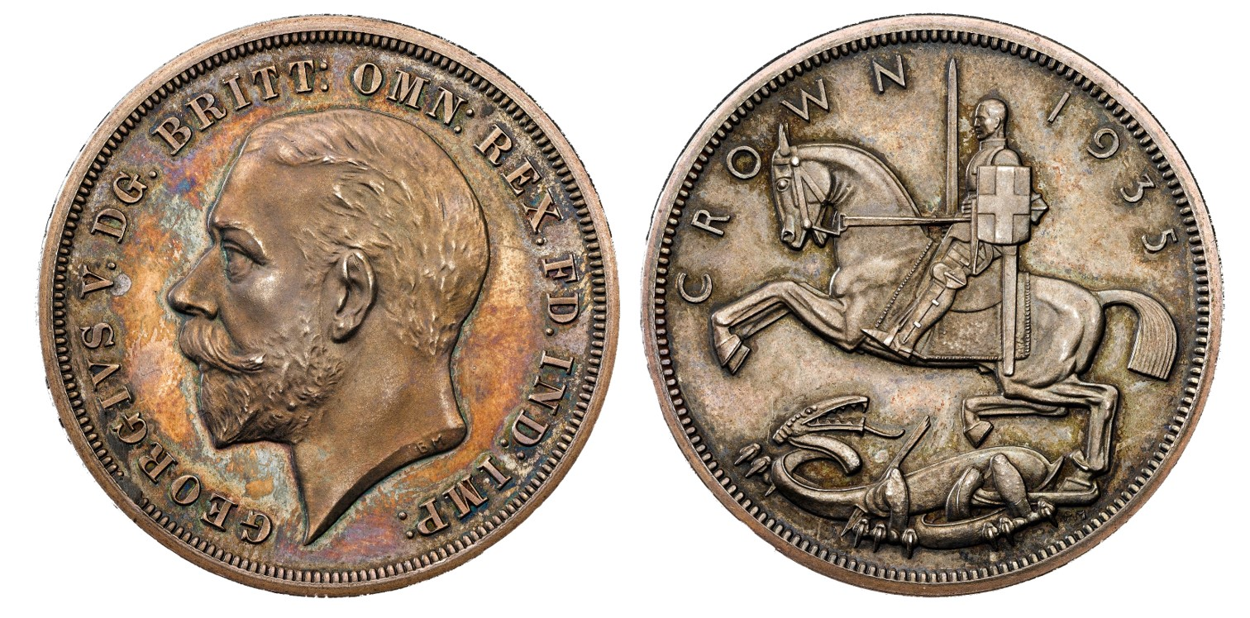
George V Silver Jubilee crown (1935) by Royal Mint

Slide 5
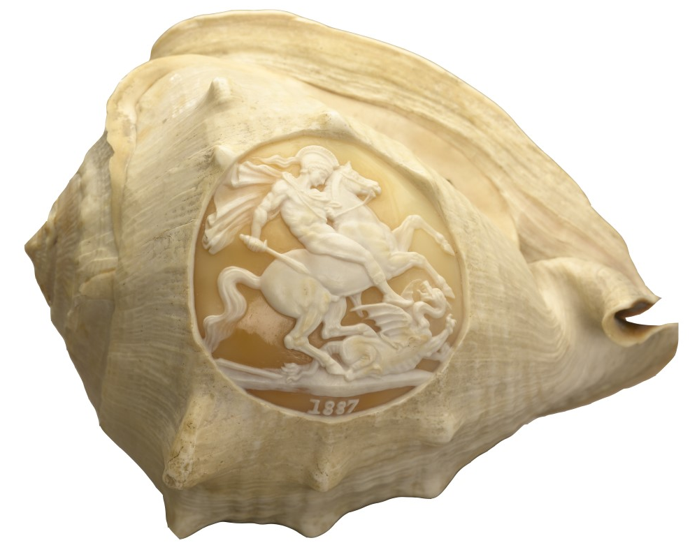
Conch shell

Slide 6
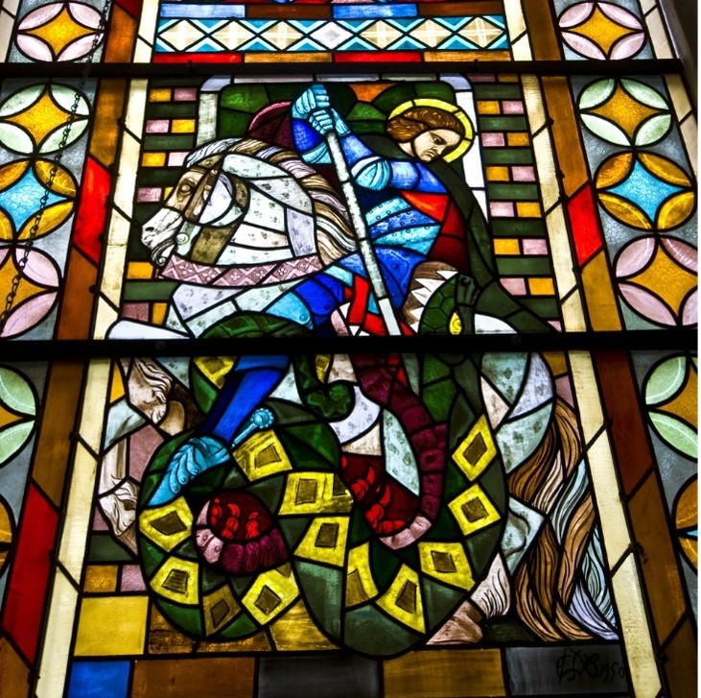
Stained glass window showing St George in a church in Hattingen
Photo credit Shutterstock_Jule Berlin

Slide 7
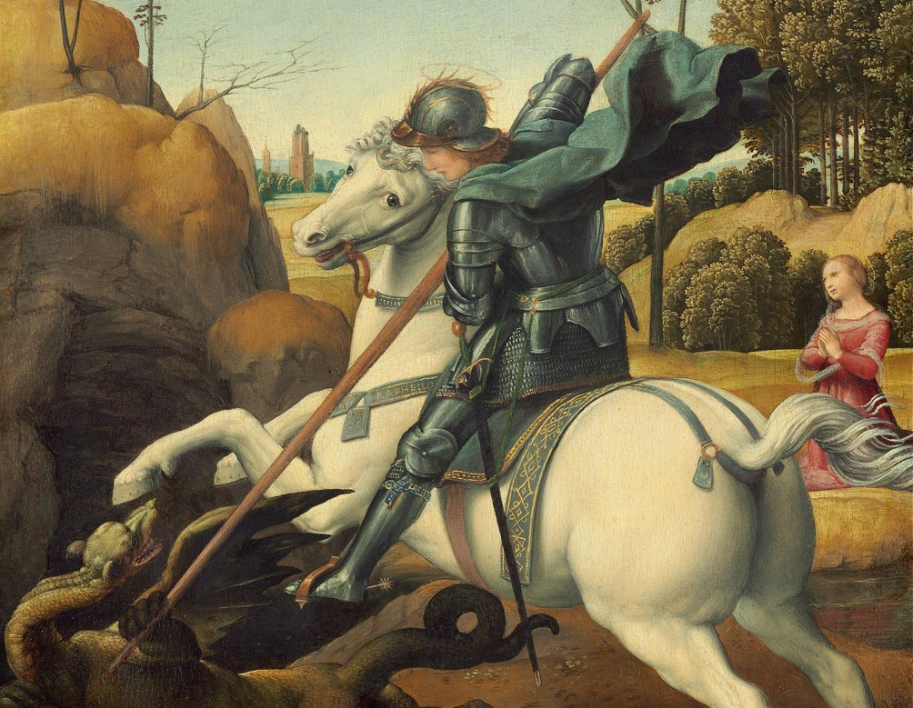
Raphael, detail of Saint George and the Dragon, 1506. National Gallery of Art, Washington D.C. Wikimedia commons.

Slide 8
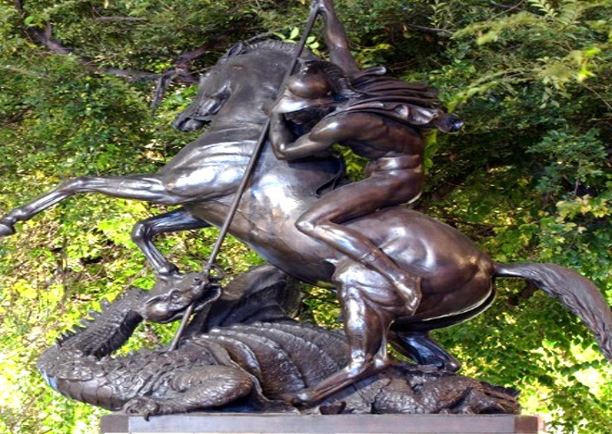
St George and the Dragon bronze statue at the entrance to the State Library of Victoria in Melbourne, Australia. Shutterstock: David L Young

Slide 9
Where else can you find
St George and the dragon?

