Slide 1

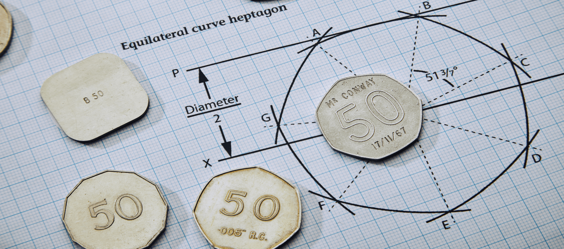
Designing the fifty pence piece
Size, shape and weight are very important in coin design and it is important to get them right so coins are easy to use.

Slide 2
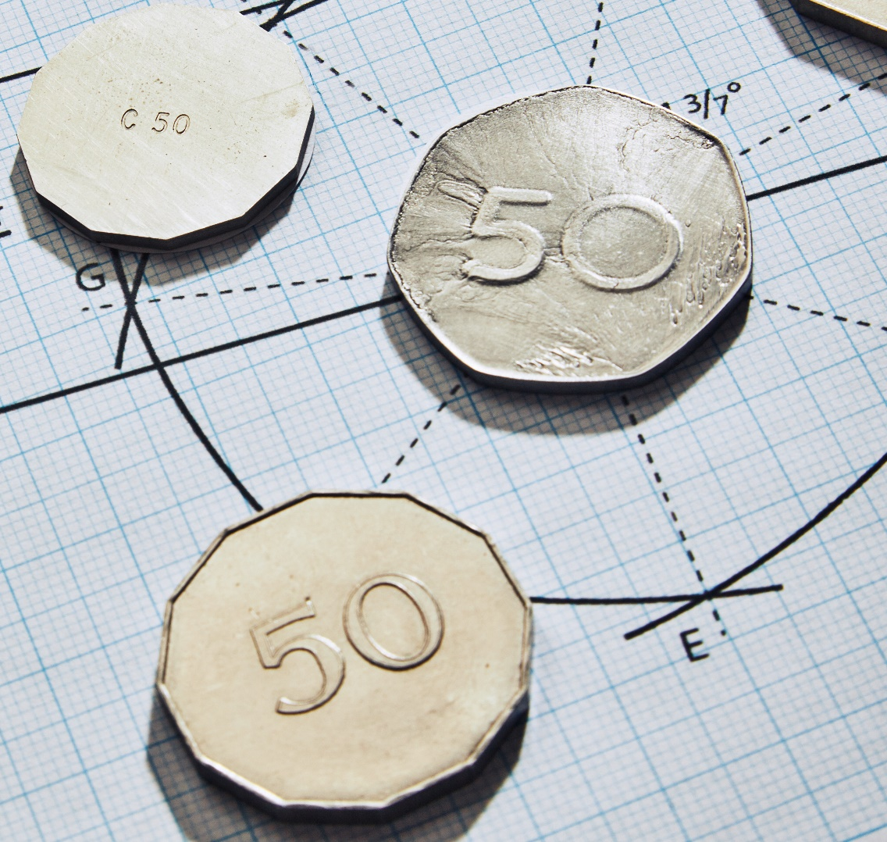
When designing the new fifty pence piece in the 1960s engineers needed to make sure the coin would:
Roll in vending machines – must be a consistent width
Be easily recognisable by touch
Last a long time in circulation
Be easy to use
The following images are trials they produced. What are the benefits and drawbacks of each one? What shapes or materials do you think they could have used to fulfil their brief?

Slide 3
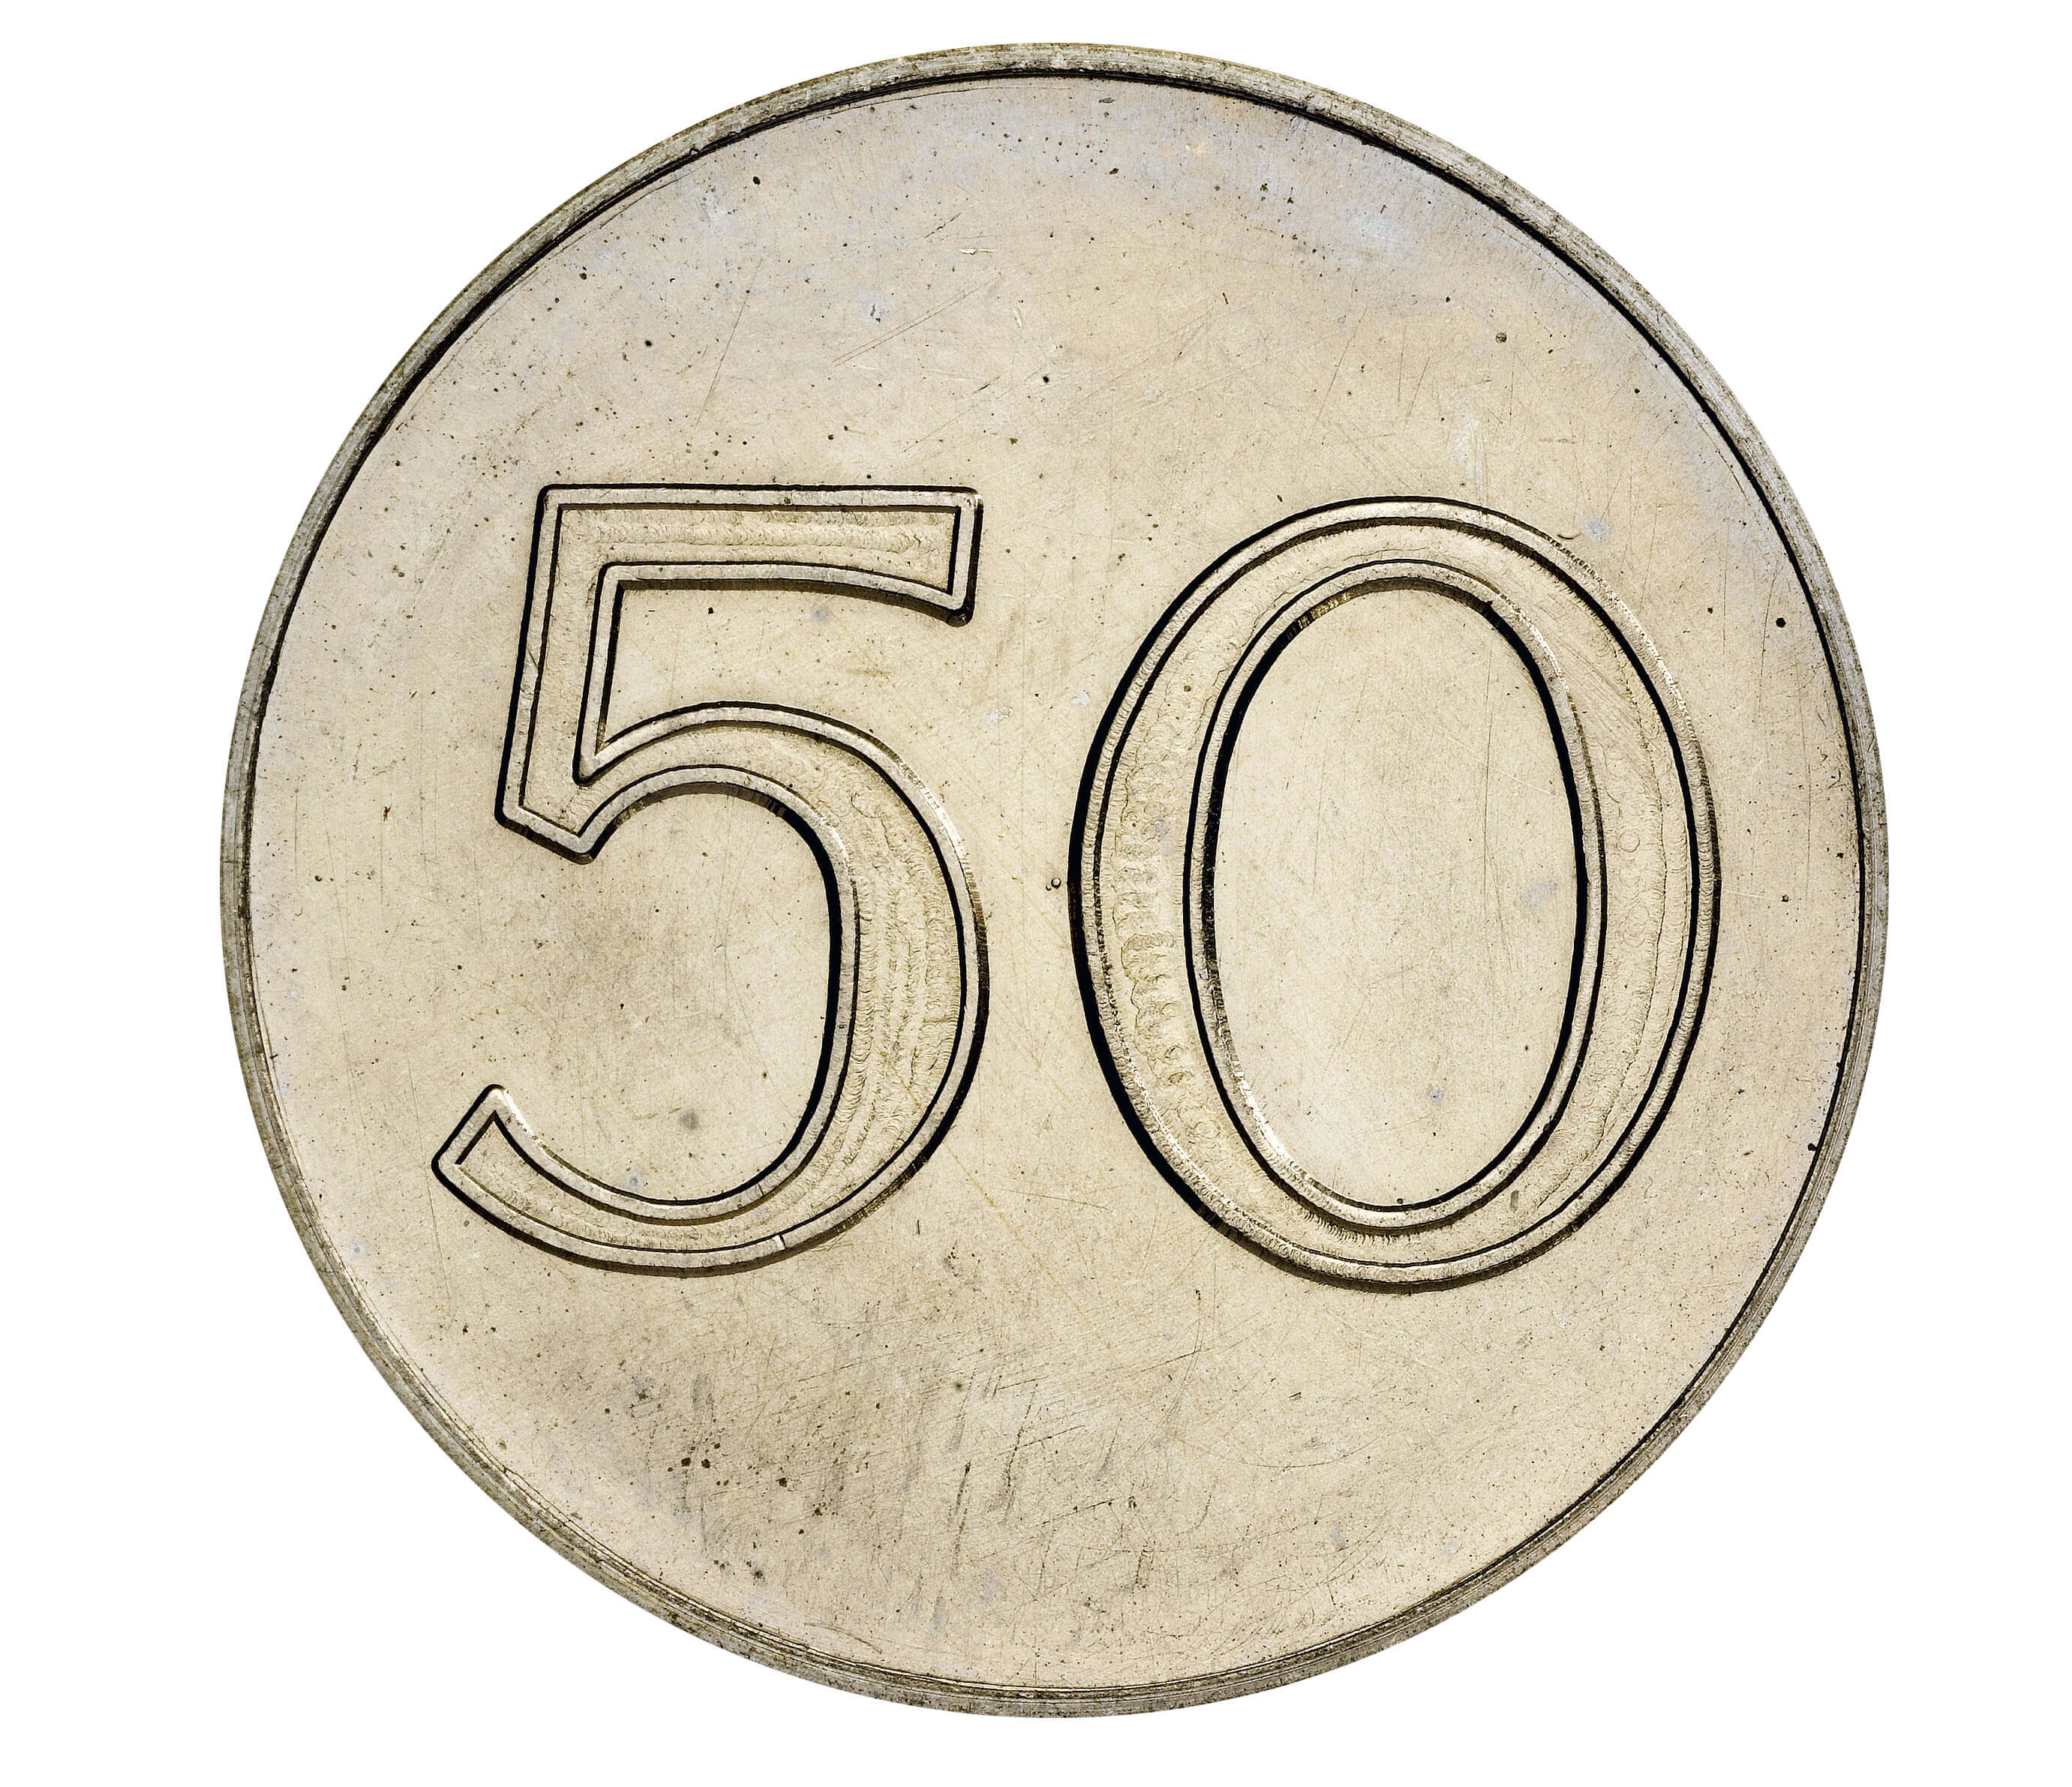


Slide 4

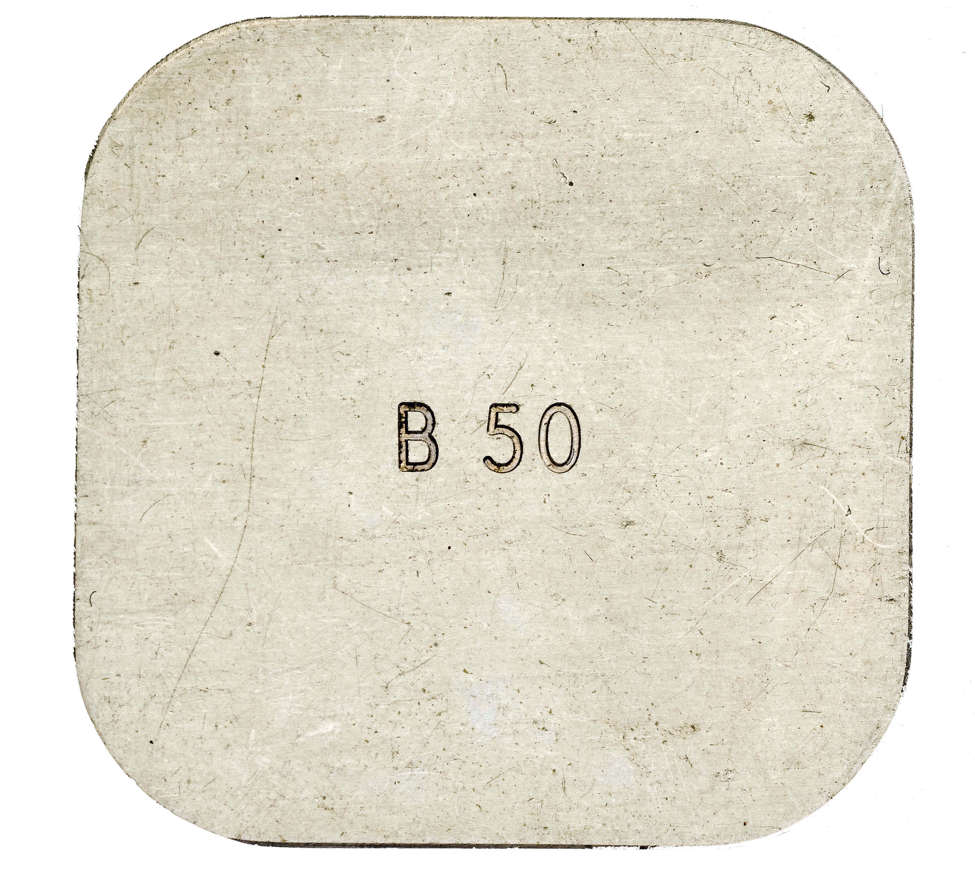

Slide 5
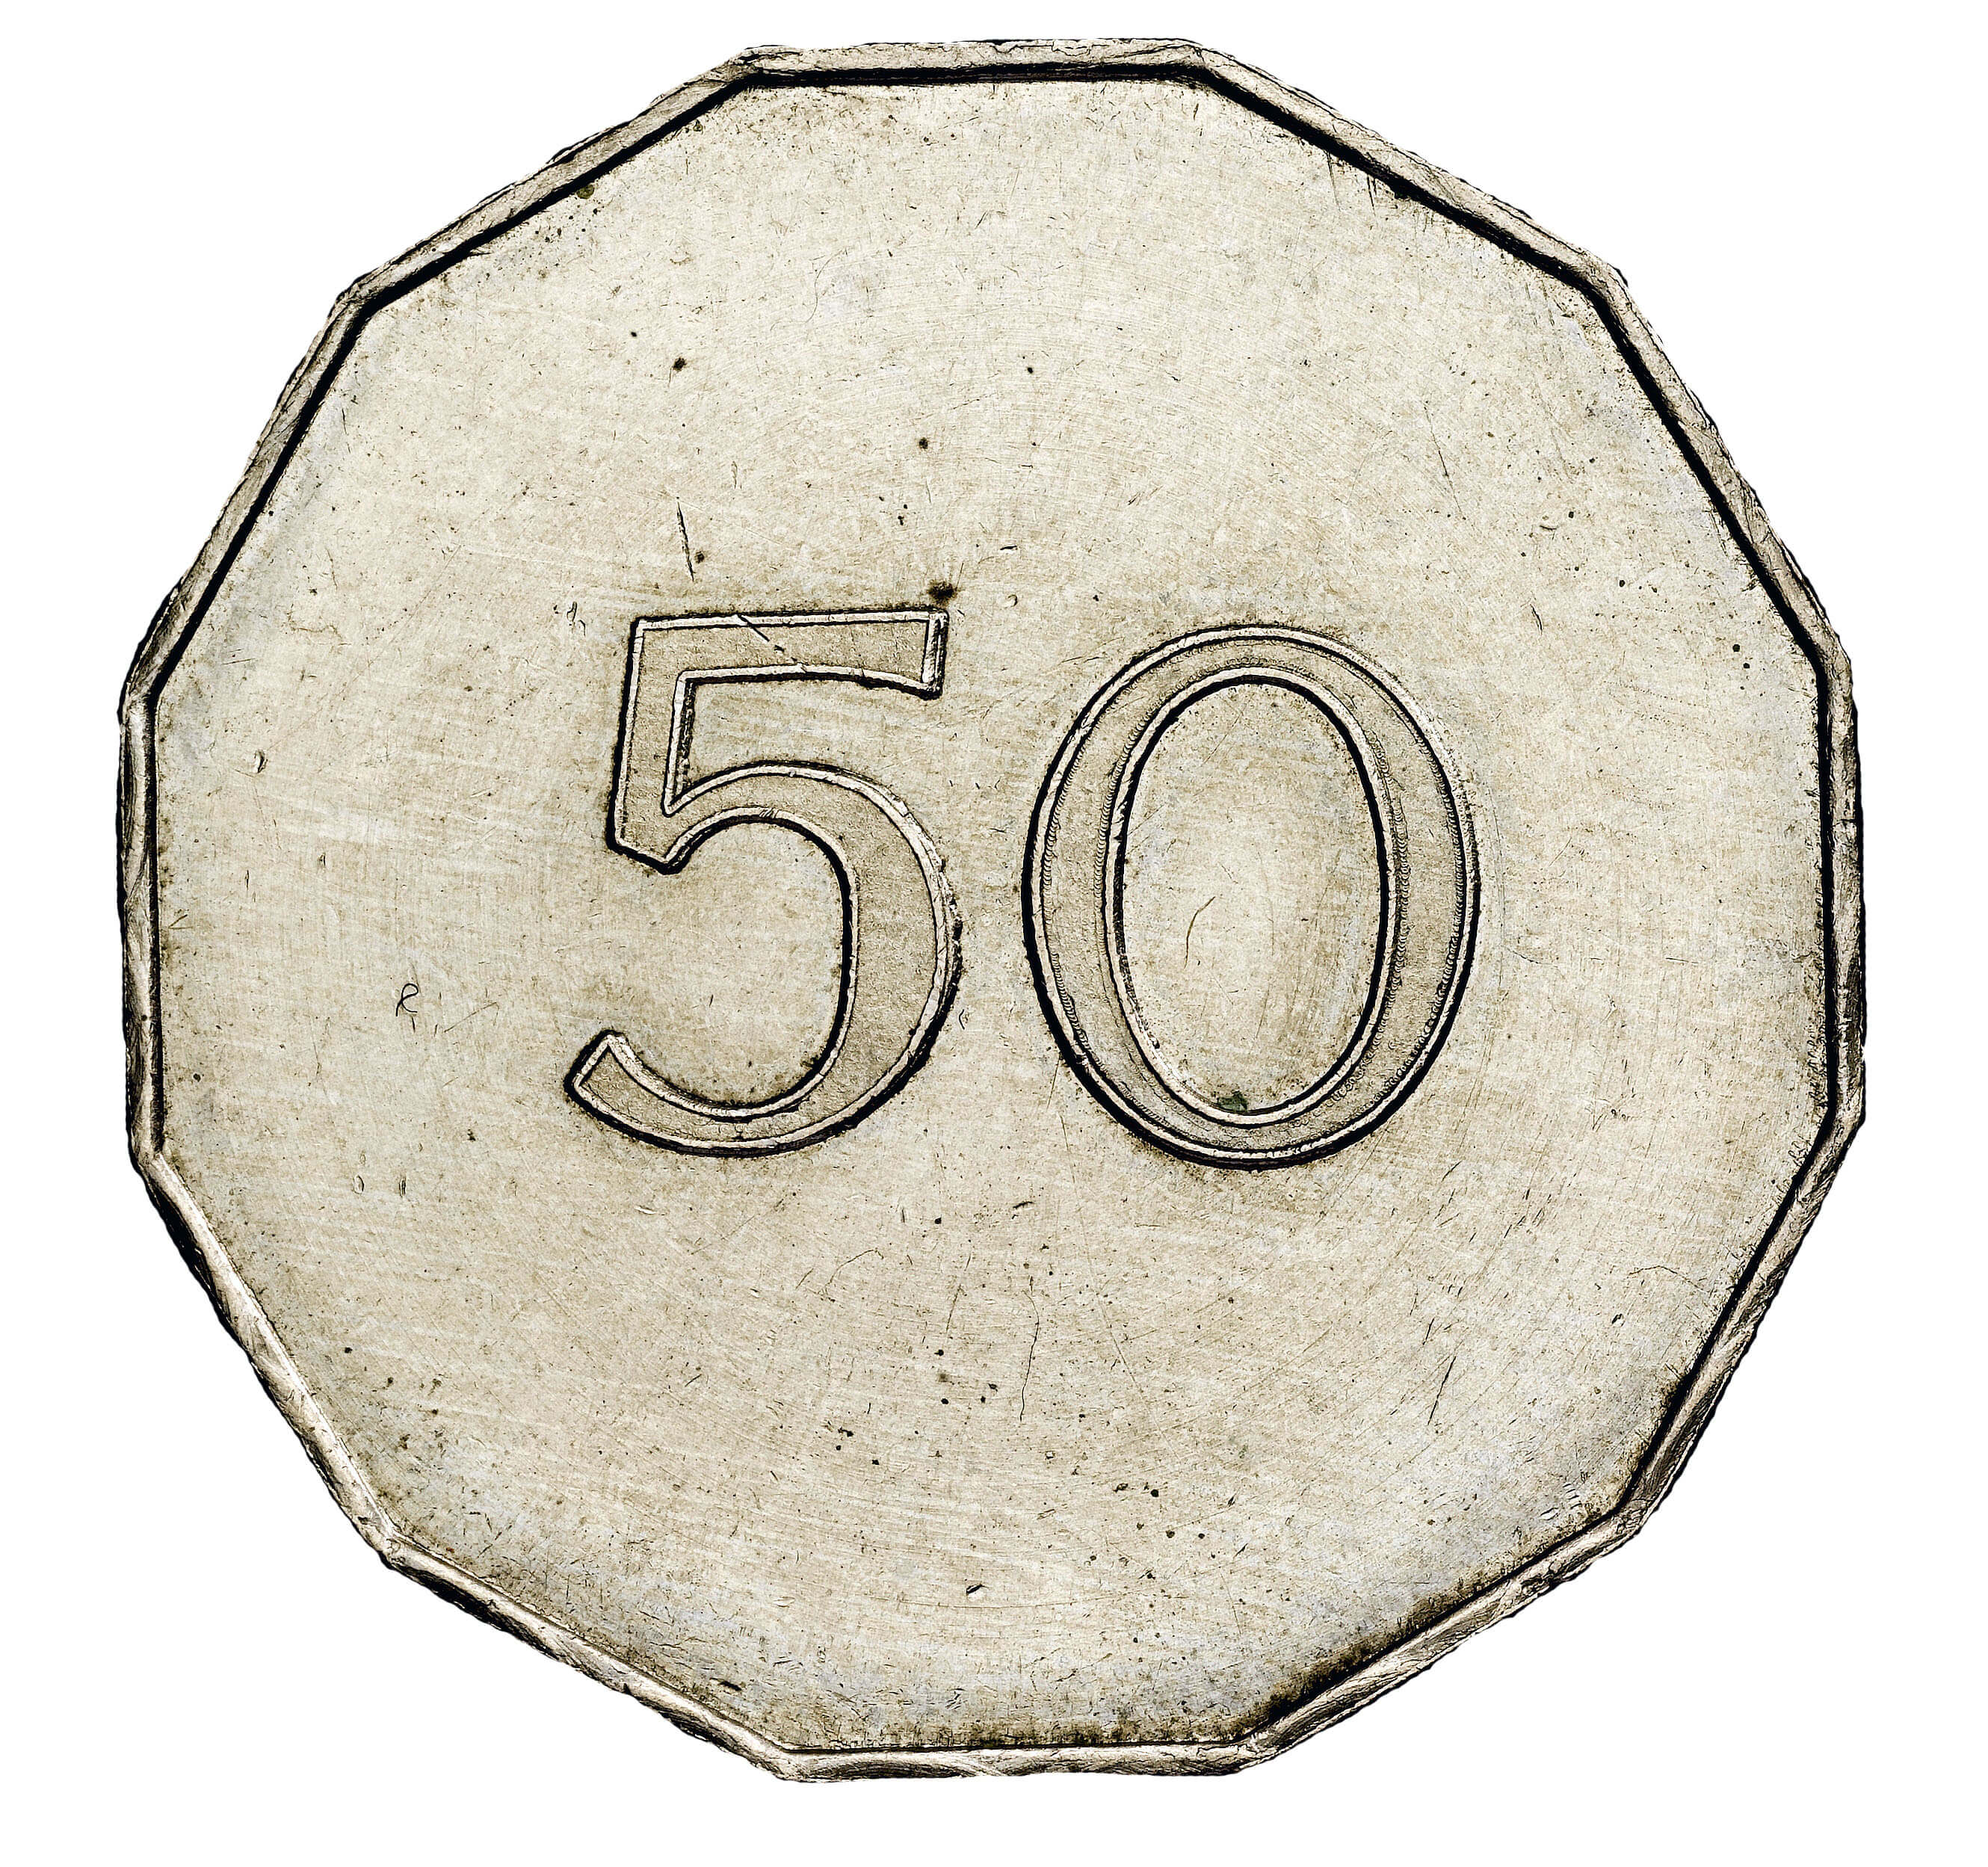

Slide 6
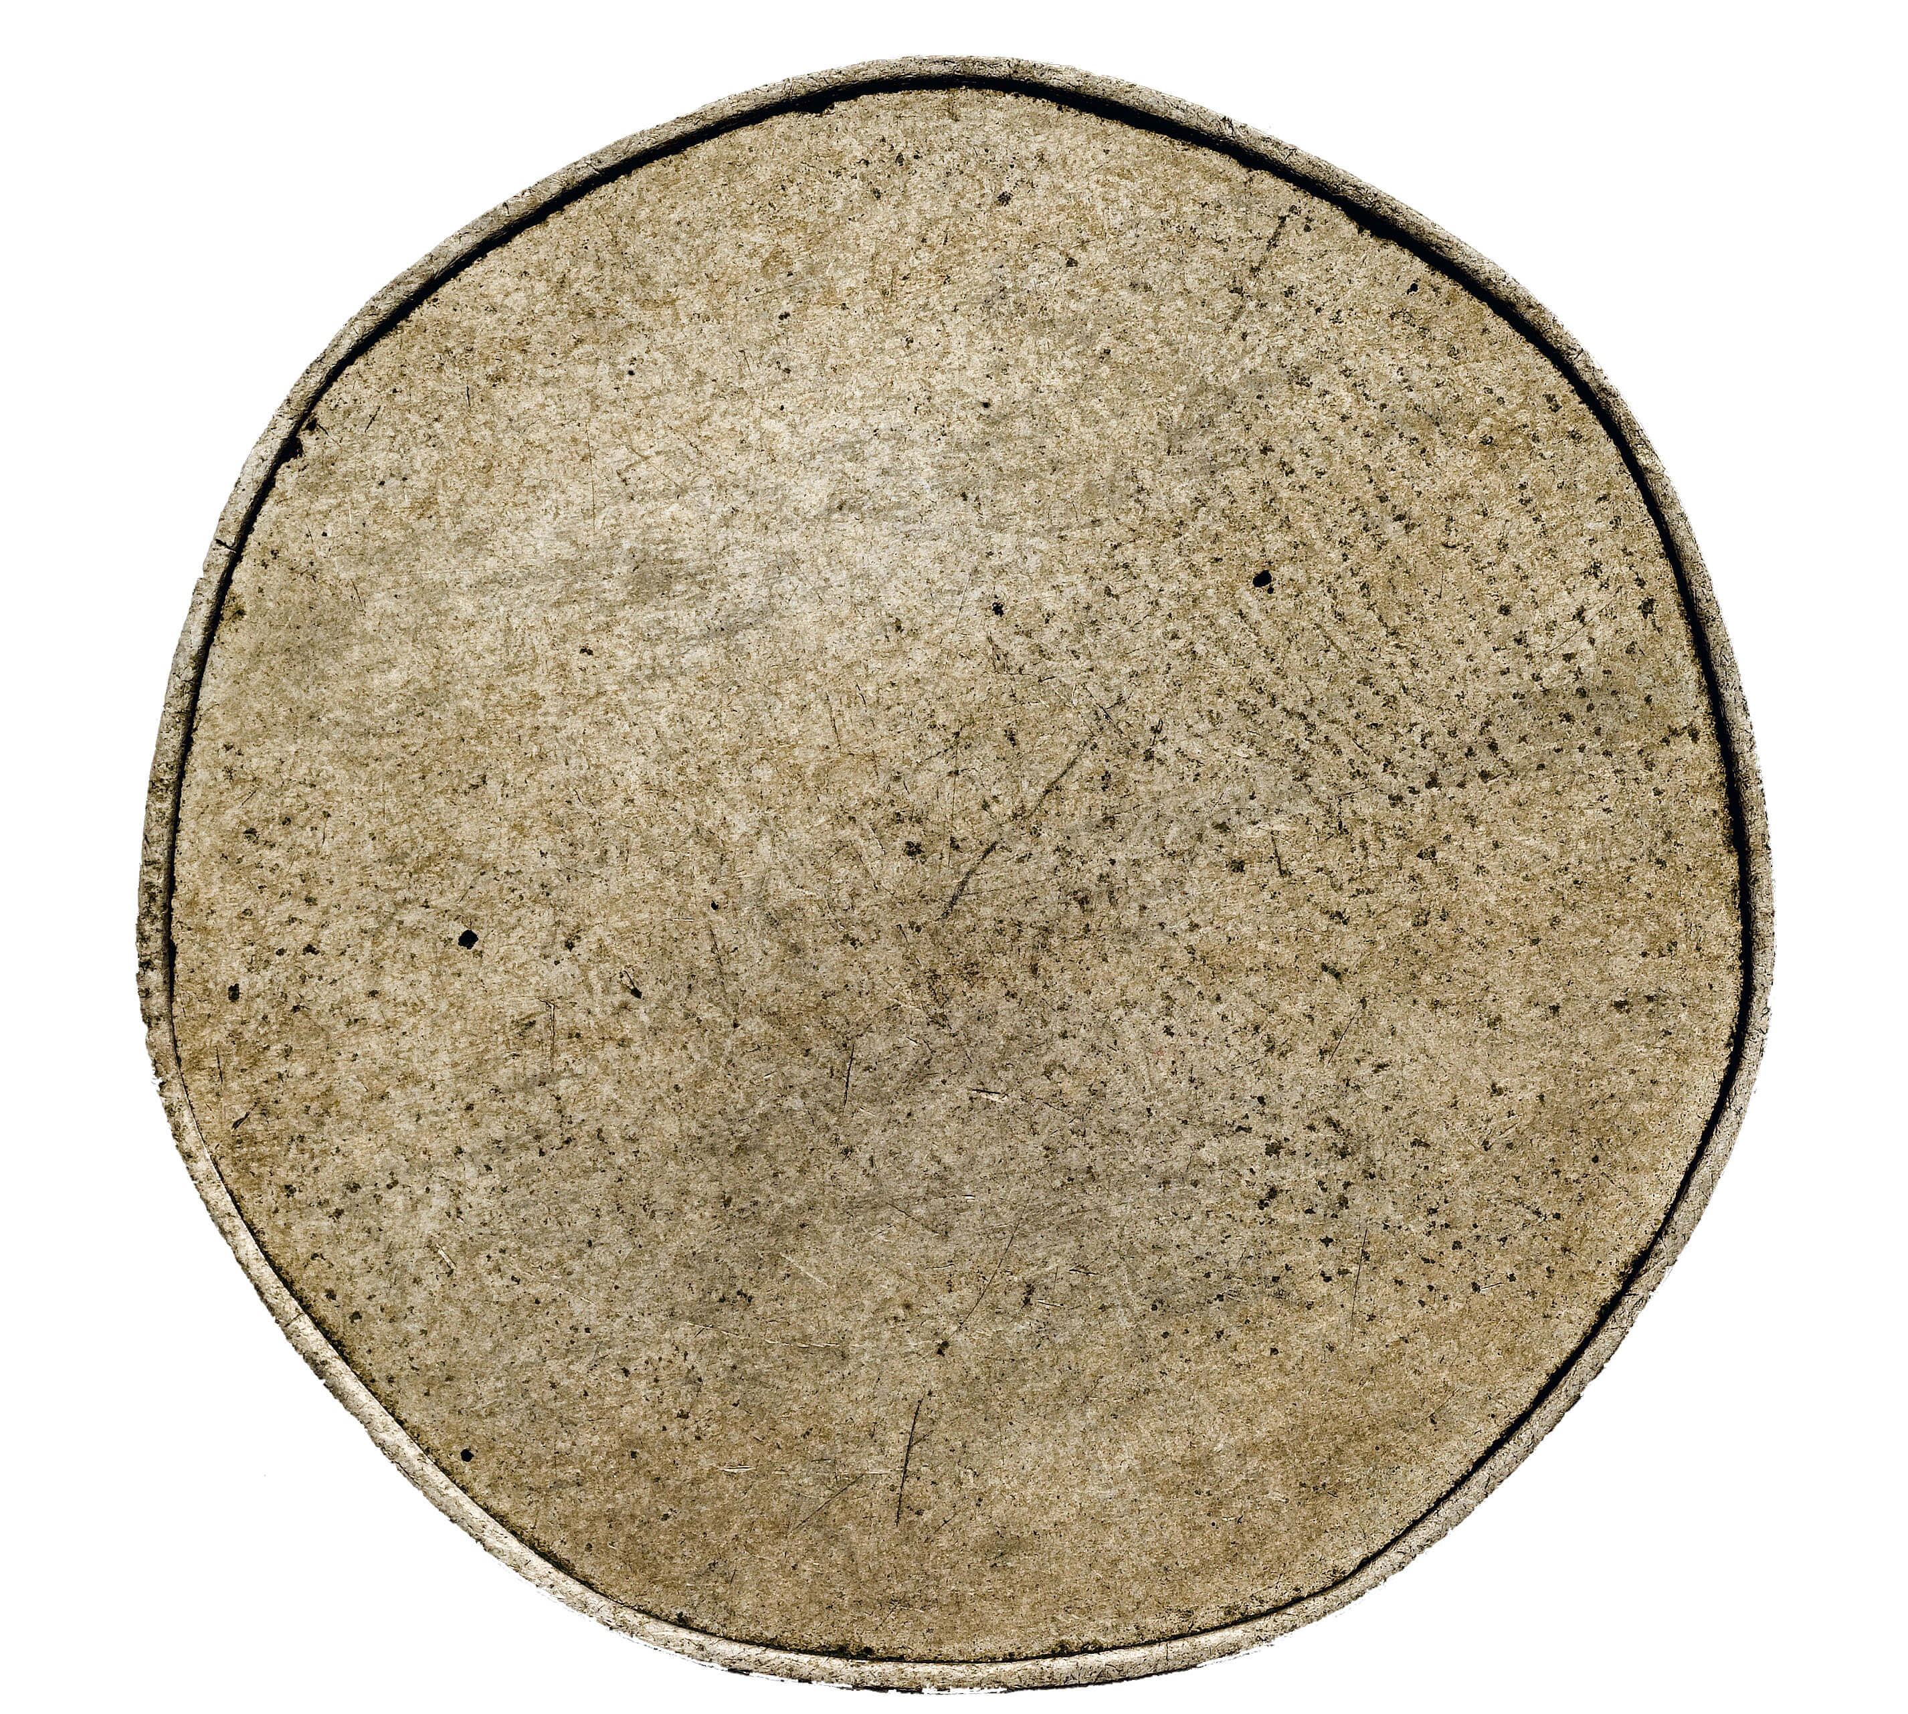

Slide 7
