Slide 1
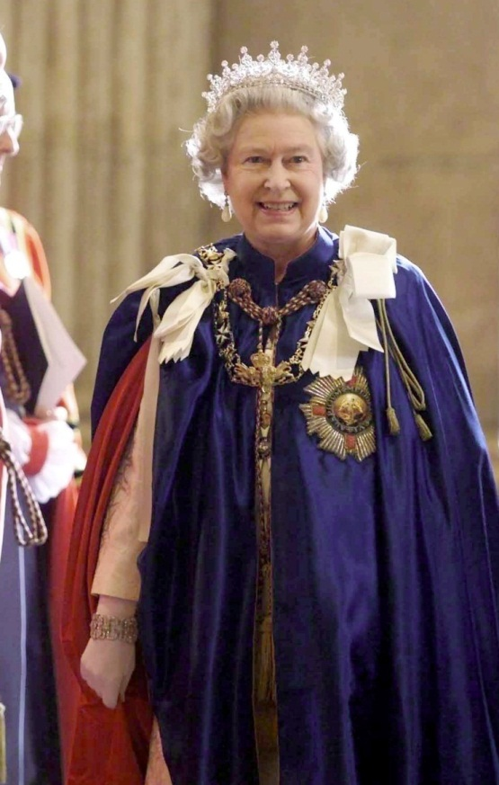
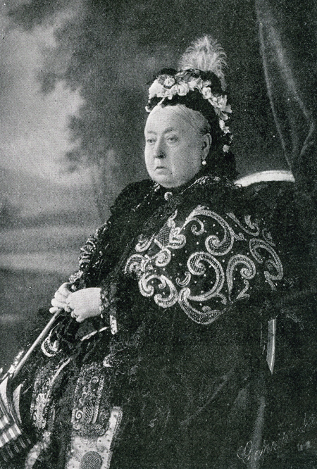
2022 will be Queen Elizabeth II platinum jubilee celebrating 70 years of her reign.
This is the longest reign of any British monarch. Even longer than Queen Victoria who was on the throne for almost 64 years.
Queen Elizabeth II
Queen Victoria

Slide 2
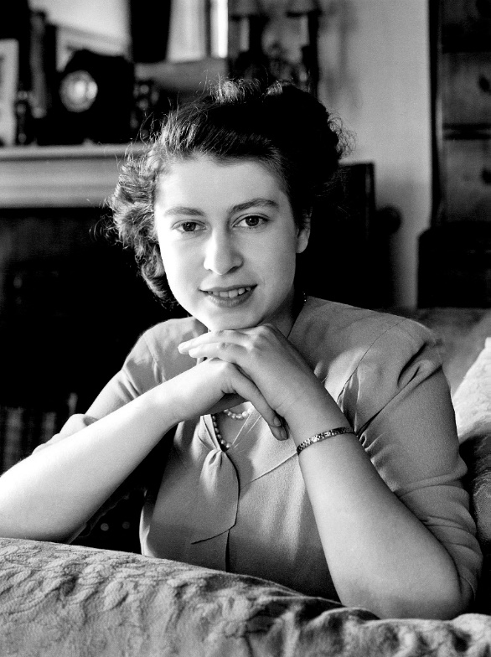
Though Elizabeth became Queen in 1952, her coronation was held the following year in 1953.
A coronation is a ceremony during which the monarch is officially accepted as King or Queen. They are given special robes, and objects which symbolise their promise to protect their people and be a just and fair ruler. They are anointed with holy oil and most importantly, a royal crown is placed upon their head.

Slide 3
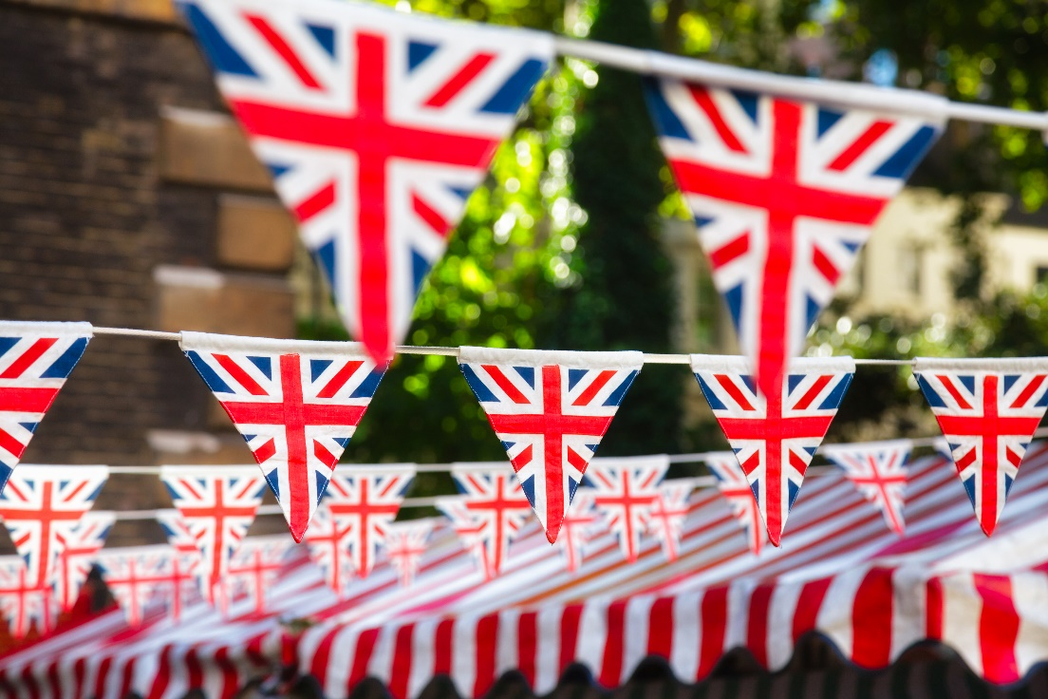
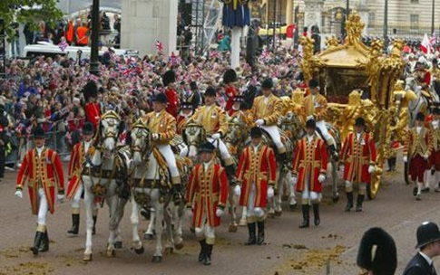
A popular way of celebrating a jubilee is to hold a street party, where neighbours get together to celebrate in the street outside their homes.
Street party bunting
The Queens Golden Jubilee celebrations
2002

Slide 4
Here are some ideas for your story;
The Queen has reigned for 70 years, think about all the things which have changed over her long reign.
If you were King or Queen for the day, what would you do? Would you like it? Put yourself in the Queen’s shoes.
Write a story celebrating a jubilee through the perspective of the Queen’s Corgis.
Thousands of years in the future, historians will look back on the long reign of Queen Elizabeth II – what will they say?

