Slide 1
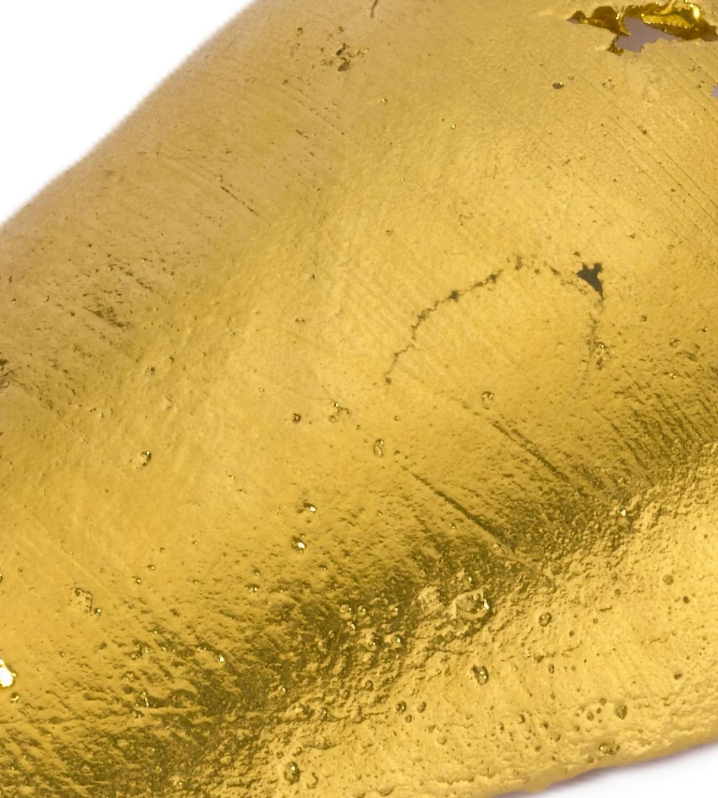

What is gold?

Slide 2
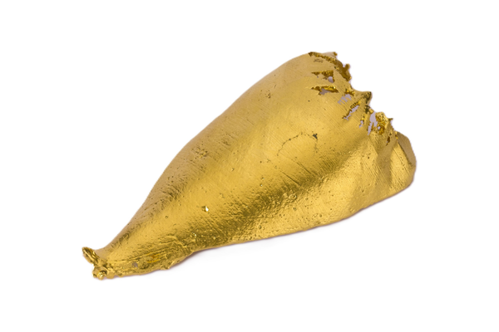
Gold is a metal.

Slide 3
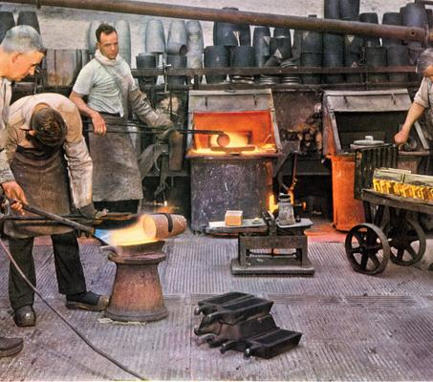

Gold is solid at room temperature, with a high melting point.

Slide 4
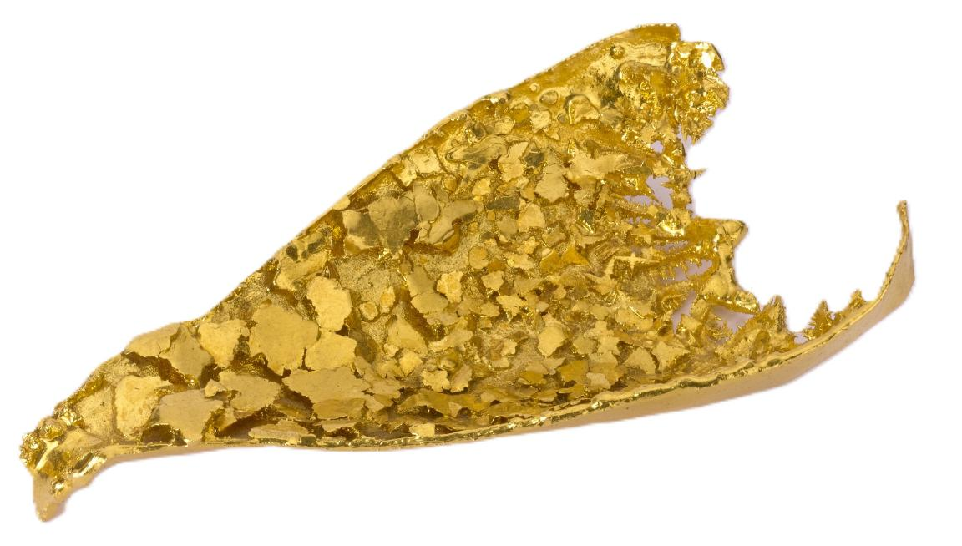
Gold is rare.

Slide 5
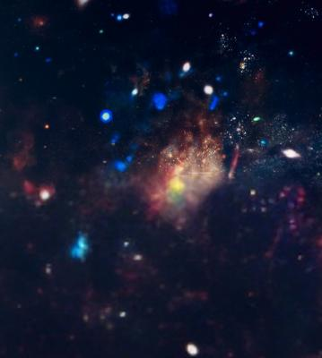
Where does gold come from?

Slide 6
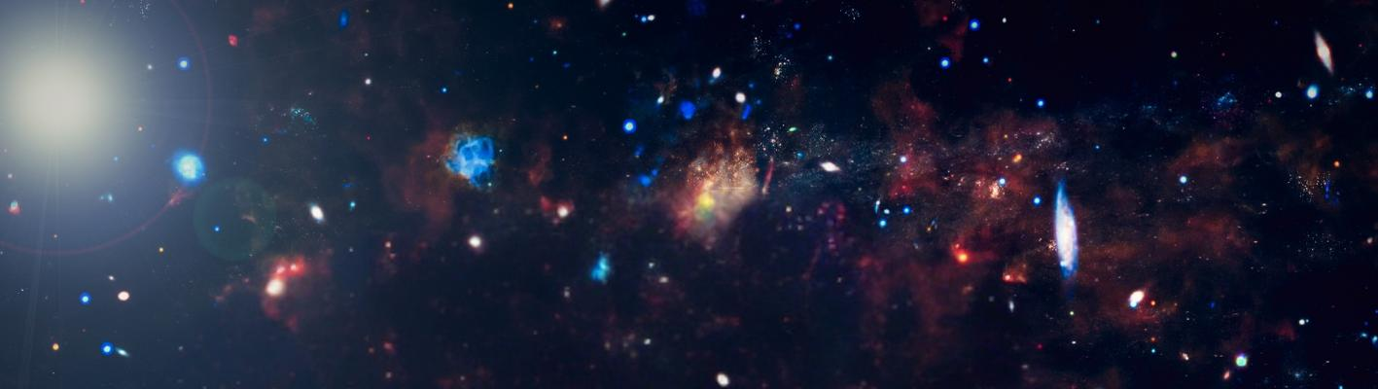
It was formed when exploding stars cast elements into space, reached the earth through meteorites that landed deep in the ground, and then slowly formed into gold.

Slide 7
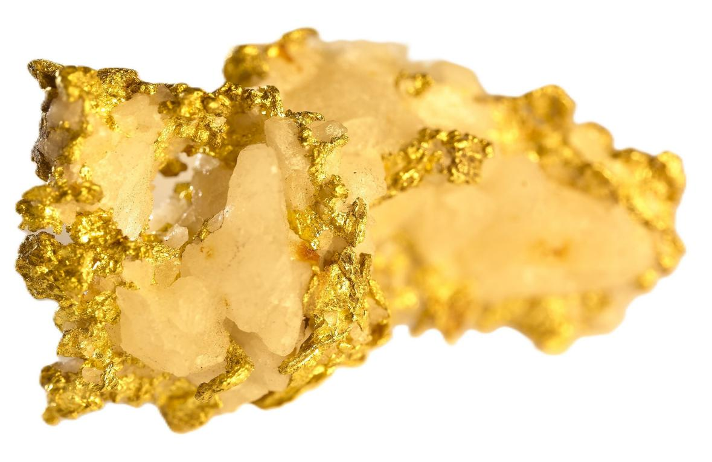
Gold mining

Slide 8
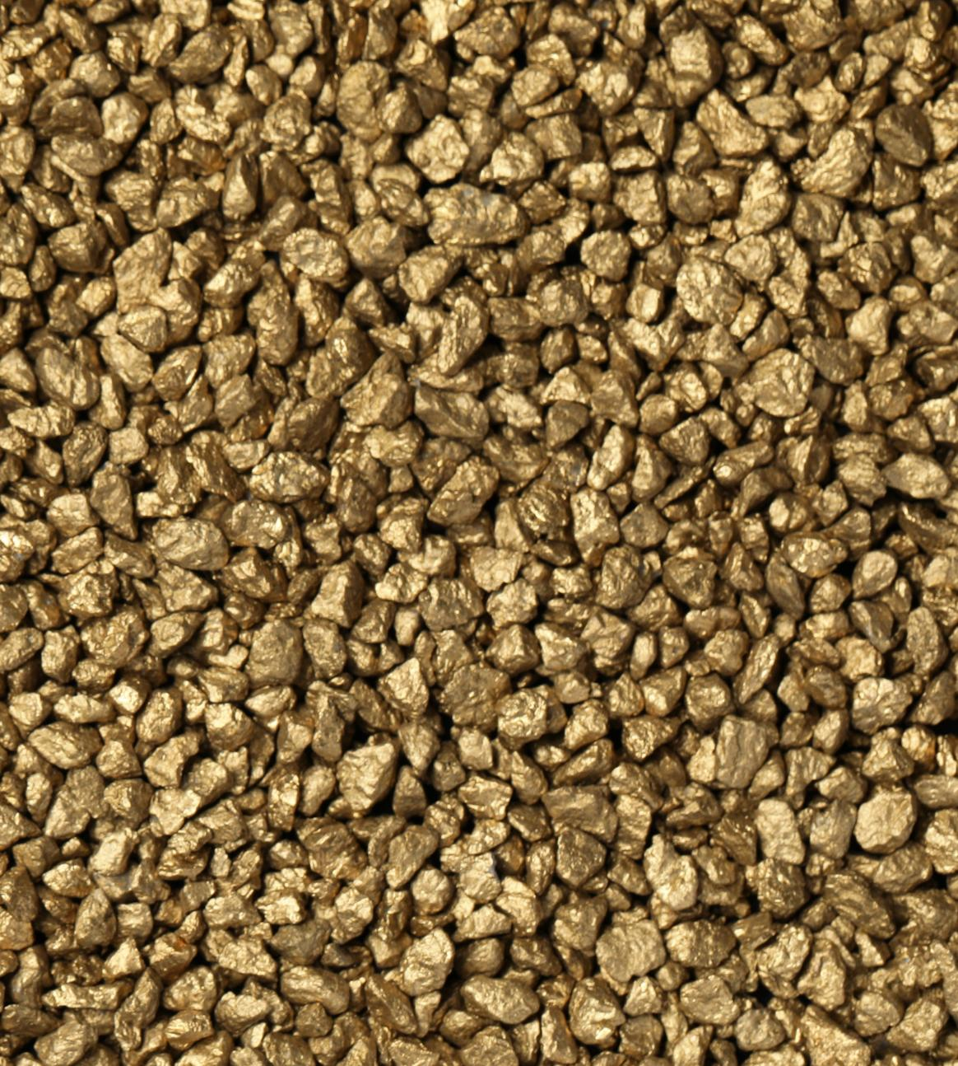
How is gold used?

Slide 9
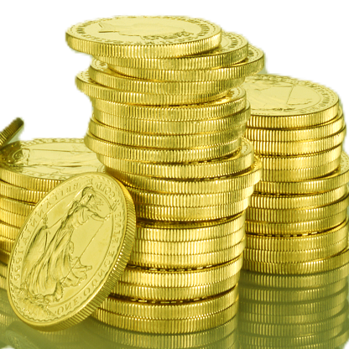
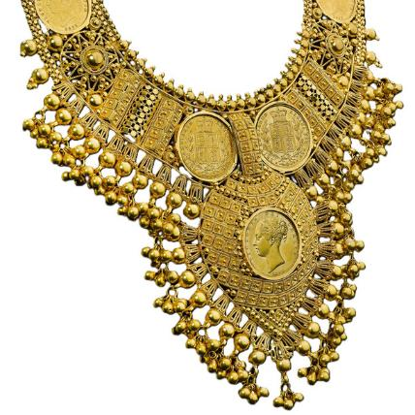
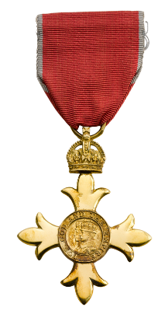
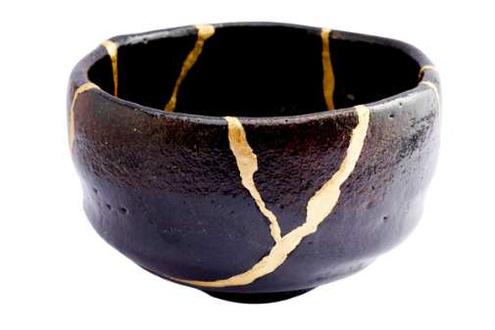
Currency
Jewellery
Art
Status Symbol

Slide 10
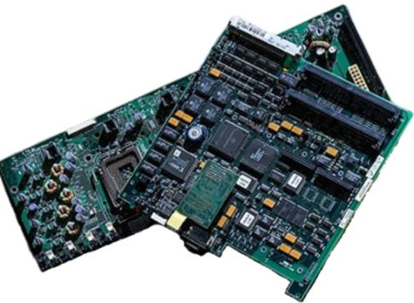
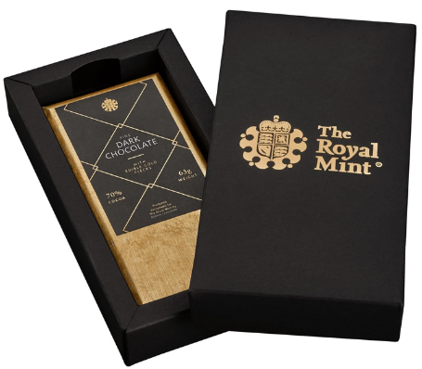
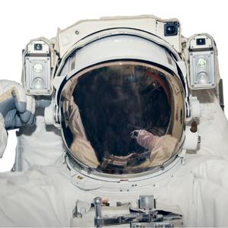
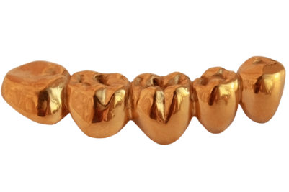
Food and drink
Technology
Space exploration
Dentistry

Slide 11
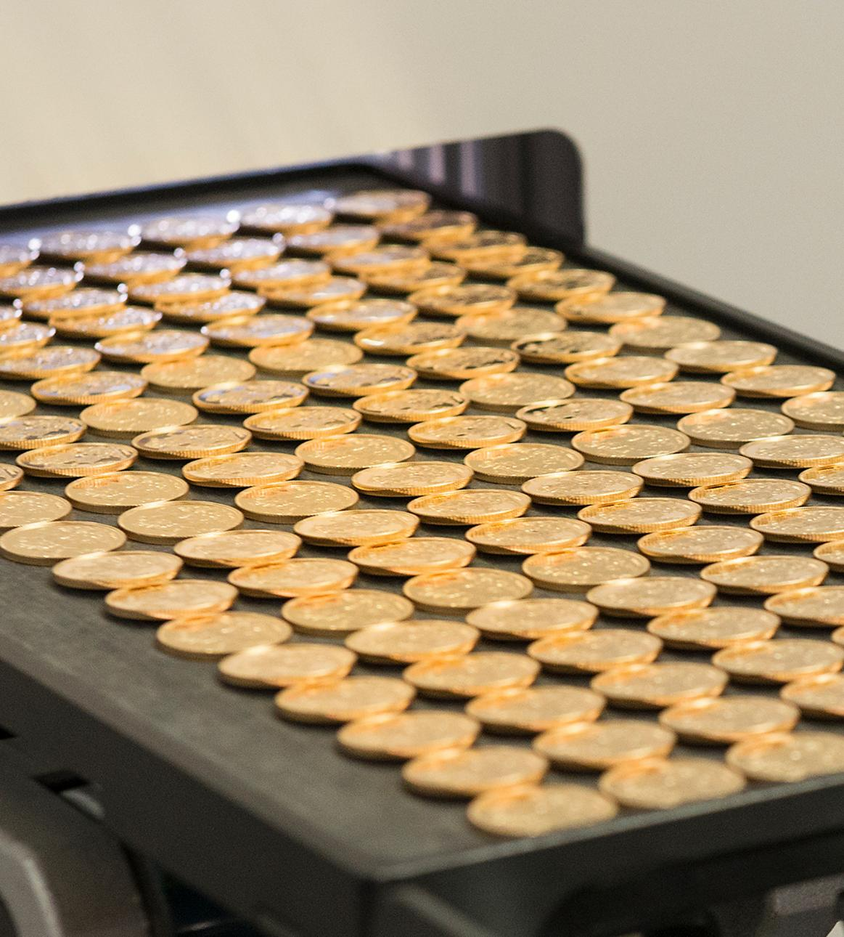
How does the Royal Mint use gold?

Slide 12
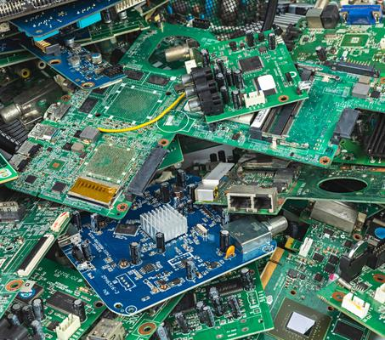
The Mint has a new process of recycling gold from electronic waste.

Slide 13
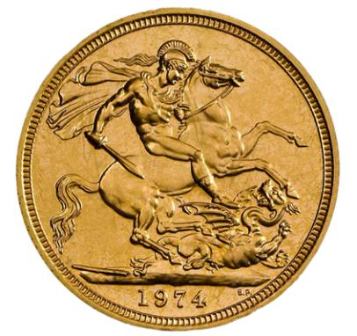
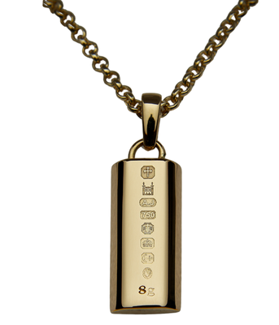
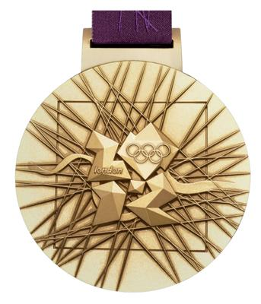
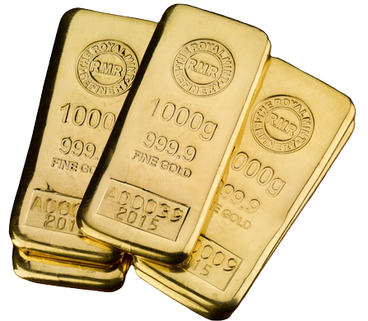
Gold coins
Jewellery
Bullion bars
Medals

Slide 14
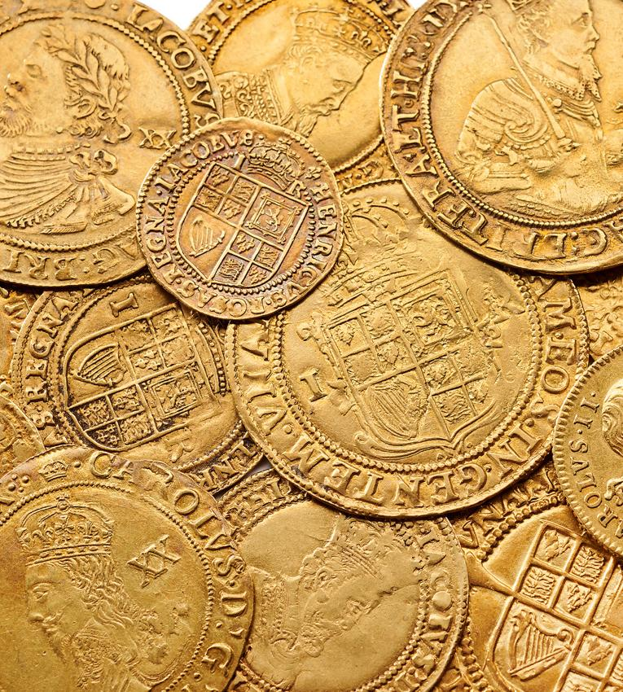
Is there gold in the Royal Mint Museum’s collection?

Slide 15
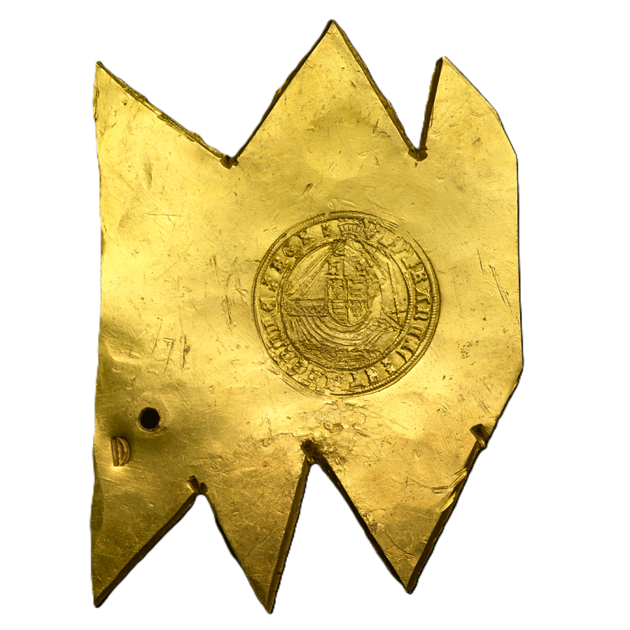
There are many gold coins and objects in the Museum’s collection.

Slide 16
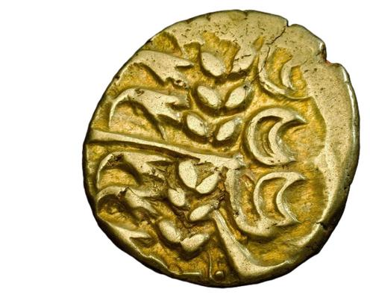
This coin is one of them. It’s from a hoard, which means a collection of gold or other treasures that have been hidden or buried.

Slide 17
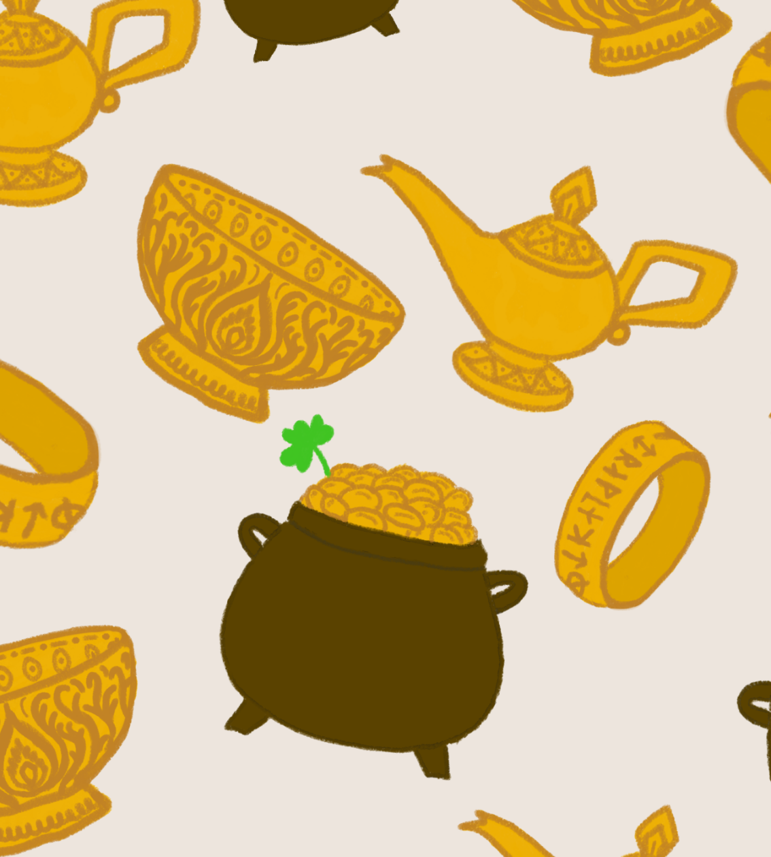
What stories have been told about gold?

Slide 18
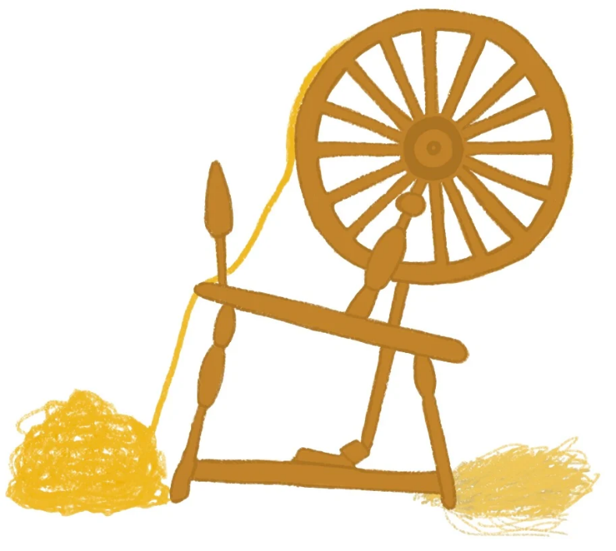
There are many fairy tales about gold. Rumpelstiltskin spun straw into glistening gold.

Slide 19
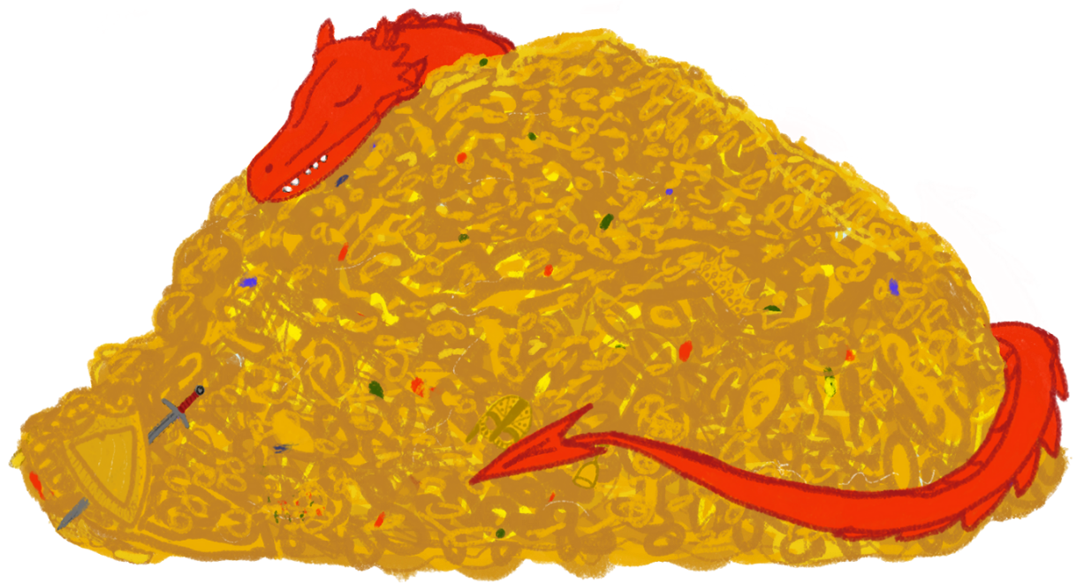
The Ancient Greeks believed dragons were giant serpents who guarded golden treasure.

Slide 20
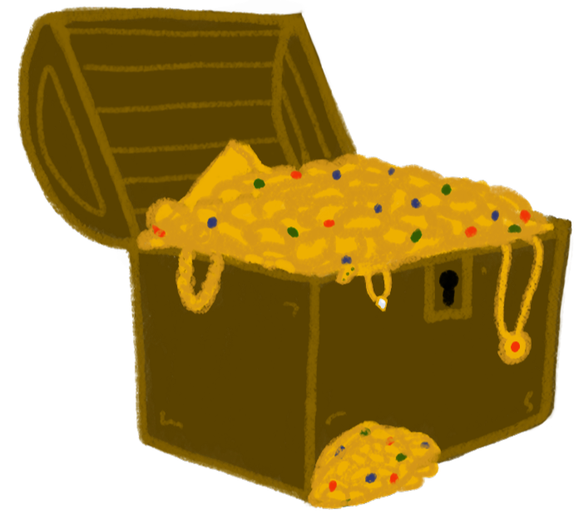
Stories of buried and hidden treasure, like El Dorado, have captured imaginations for centuries.

Slide 21
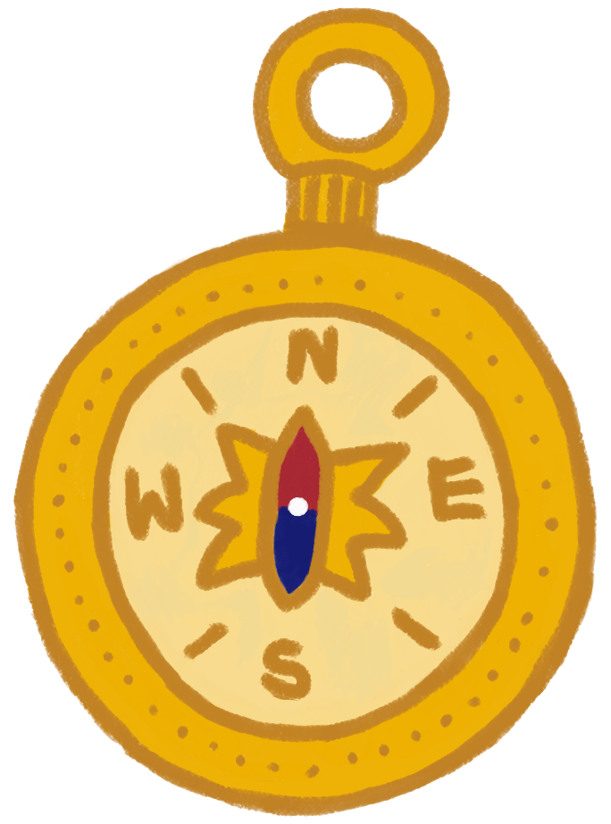
There are adventures about pirates searching for gold, like Treasure Island.

Slide 22
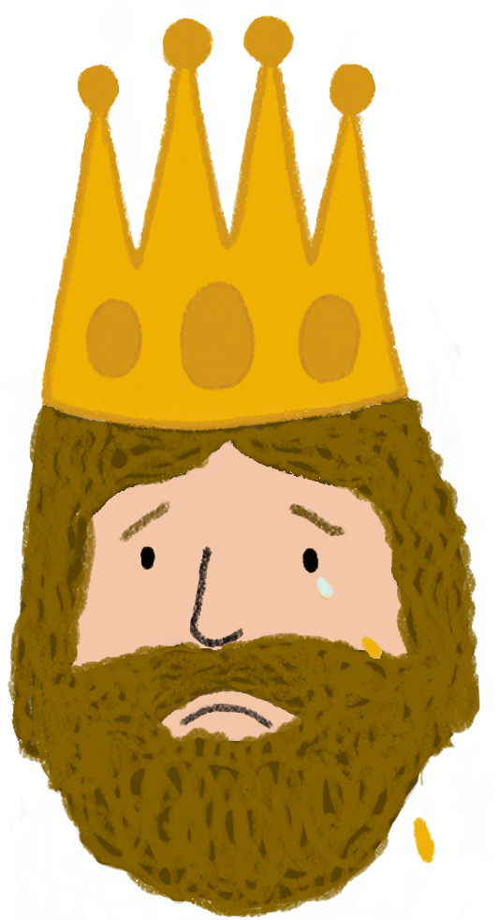
Gold is often used as a warning for greed, like the Greek Myth of King Midas.

Slide 23
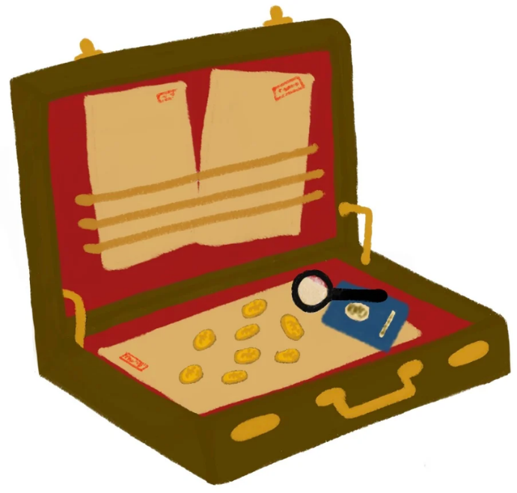
James Bond had a secret compartment for gold coins in his briefcase. This was based on real-life secret agents.

Slide 24
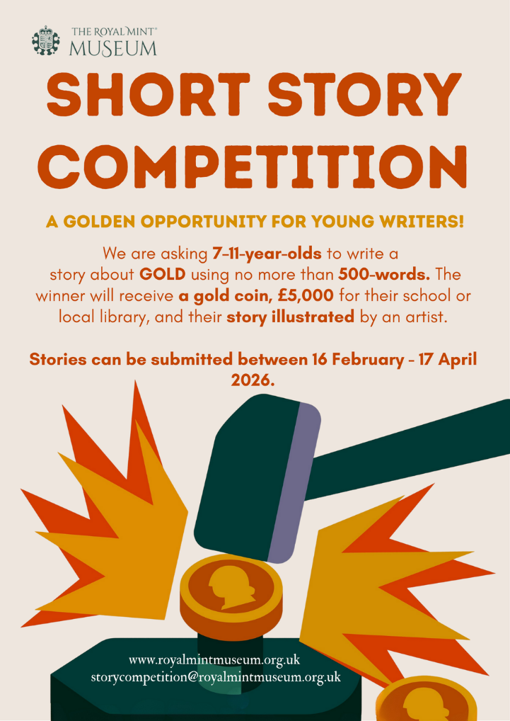
What story can you write about gold?

Slide 25
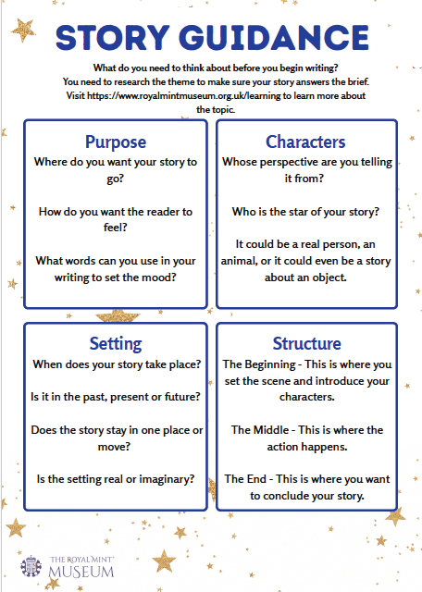
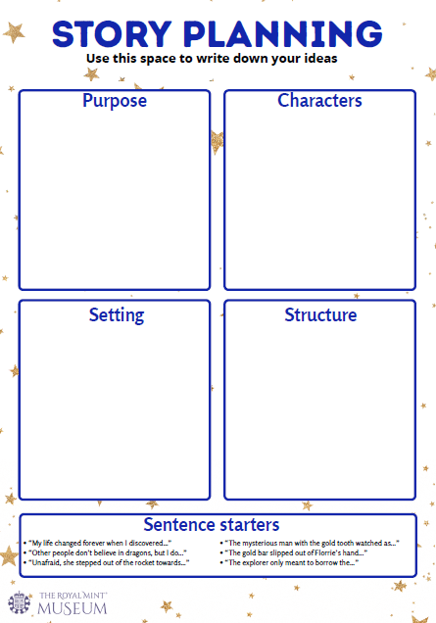
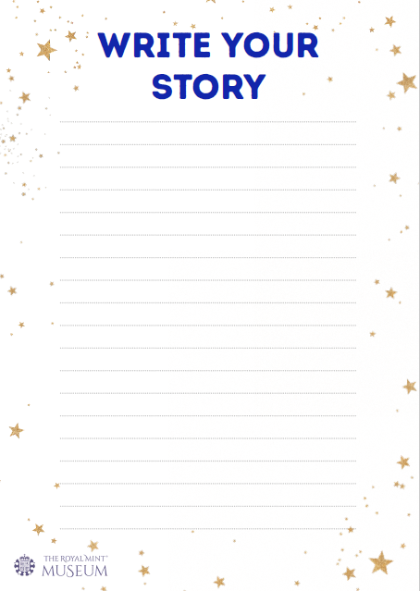
Use the Museum’s Story Worksheet to help you plan and write your story.

Slide 26
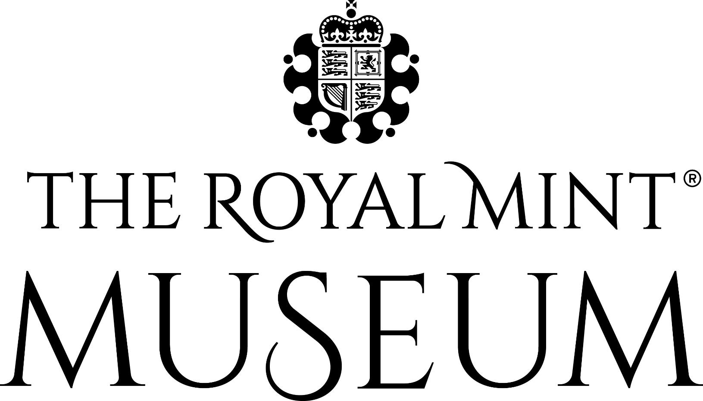
Copyright Royal Mint Museum 2026

